Slide 1
REPORTLAB COMPLETE TUTORIAL
Generate Payslip From Csv Using Reportlab Python:Part 61
TOTAL TECHNOLOGY

Slide 2


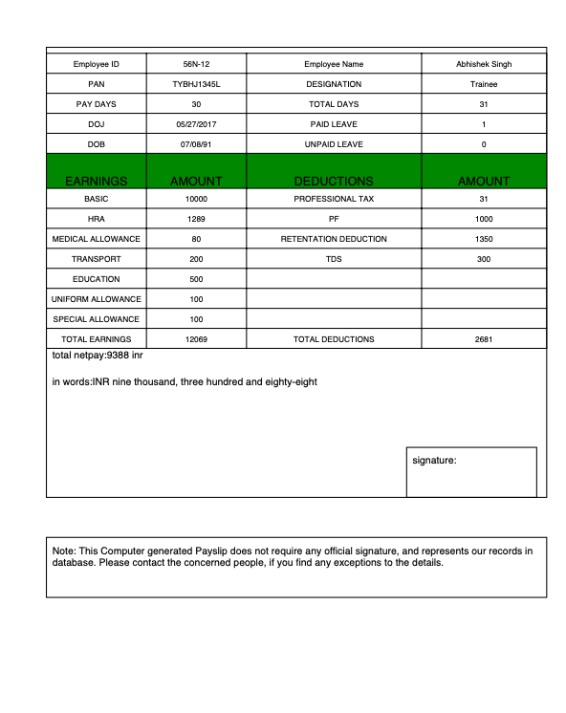

z
Payslip Template
TOTAL TECHNOLOGY

Slide 3
Code:
TOTAL TECHNOLOGY

